Slide 1
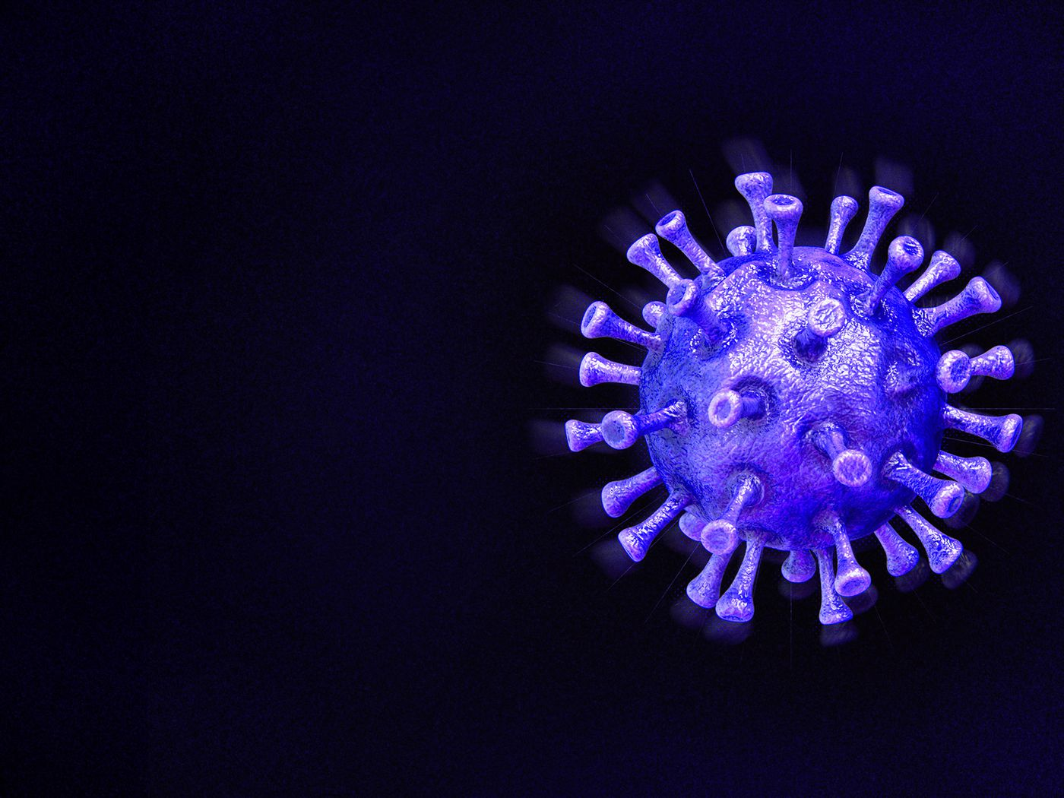
PPT Presentation of Course Completion Project
Team Members
1. Soumik Roy
2. Soumik Dhar
3. Soumik Das
4. Sankhya Dey

Slide 2

Please use Mask

Slide 3
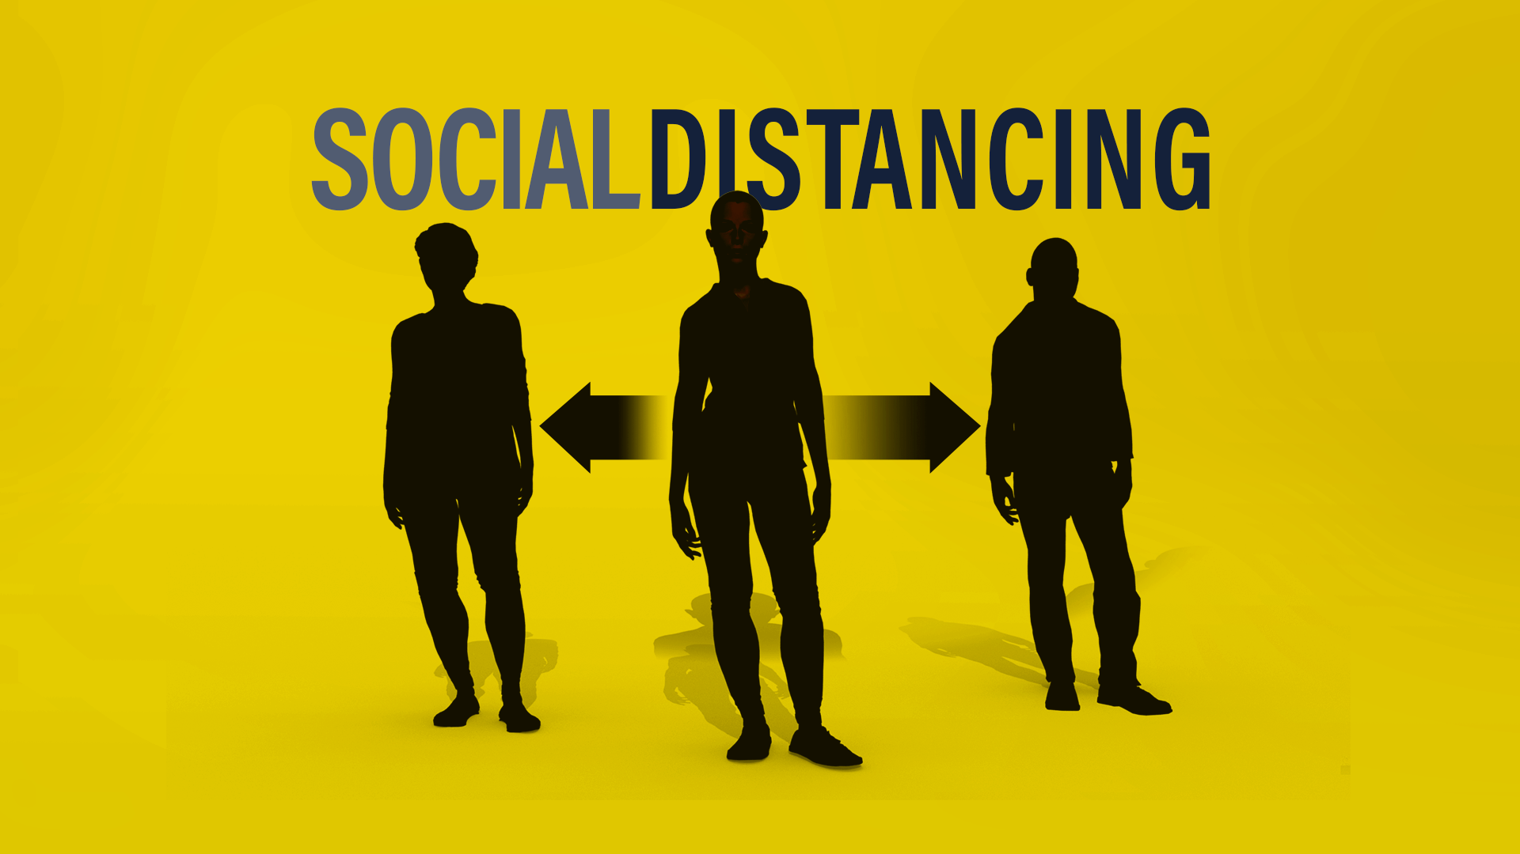

Slide 4
Highlights
The purpose of this work is to provide a deep learning platform for social distance tracking.
The framework uses the YOLOv3 object recognition paradigm to identify humans in video sequences.
The transfer learning methodology is implemented to increase the accuracy of the model.
To estimate social distance violations between people, we used an approximation of physical distance.

Slide 5
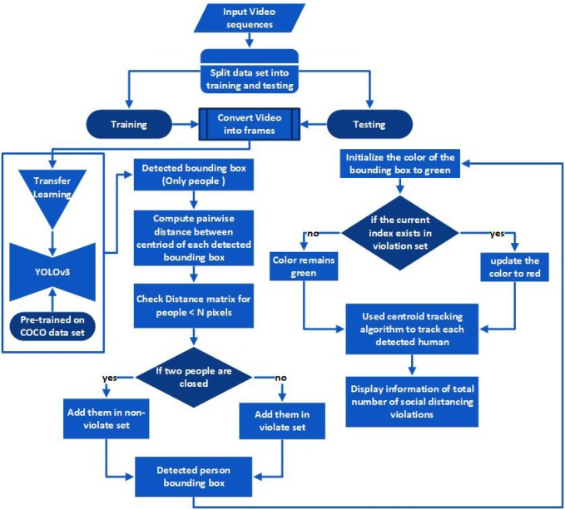

Slide 6
SOCIAL DISTANCING DETECTION
OBJECT DETECTION ALGORITHM
OBJECT TRACKING ALGORITHM
DISTANCE MEASURING ALGORITHM

Slide 7
OBJECT DETECTION
ALGORITHM

Slide 8
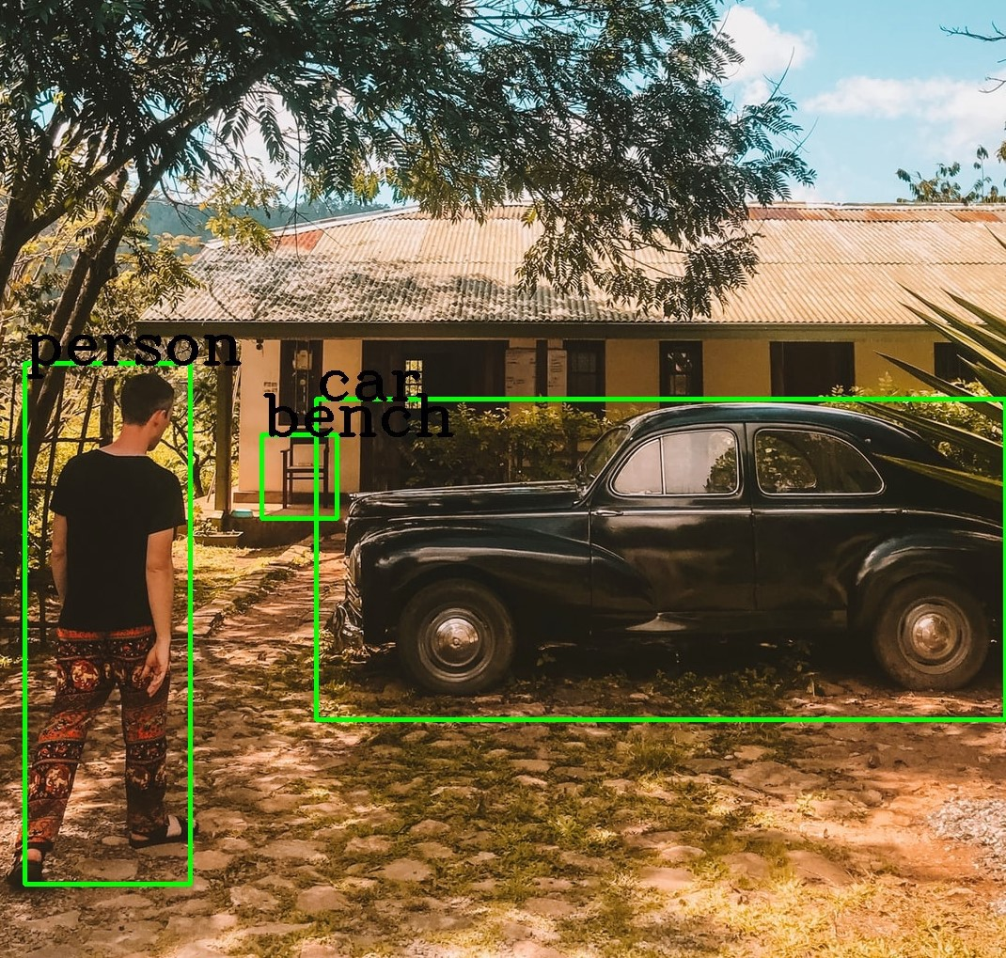
YOLO

Slide 9
Steps in YOLO
Each image is split into s*s grid cells
Works with only one grid at a time
1 grid cell can detect one object only
Limited no of bounding boxes in each grid cell
Object is detected in that grid cell only where its centre falls

Slide 10
Object Detection take place in two steps
Object localization
Object classification
Object Detection

Slide 11
Box Confidence Score :
How much confident the box is that there is an object
Gives an idea of objectness
Box confident score = P(object)*IOU
What is IOU ?? 🤔🤔

Slide 12
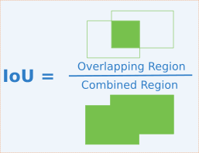
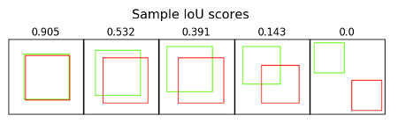
IOU(Intersection over Union)
It is a matric that allows us to evaluate how similar our predicted bounding box is to the ground truth bounding box

Slide 13
Now there is one problem…
For the same object YOLO can make duplicate detection
How to solve this problem??🤔🤔

Slide 14
The algorithm applied to solve this kind of problem is NMS(Non Maximal Suppression)
Steps to be followed…
Arrange in decreasing order of confidence score
Discard boxes having confidence score less than threshold
Start from the top scores, ignore any current prediction if we find any previous predictions that have the same class and IOU>0.5 with the current prediction
Repeat until all are checked

Slide 15
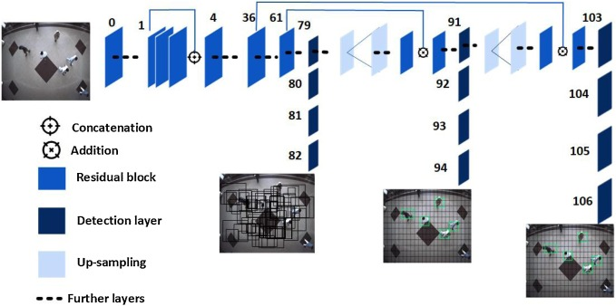

Slide 16
Object tracking with OpenCV
Object tracking is the process of:
Taking an initial set of object detections (such as an input set of bounding box coordinates)
Creating a unique ID for each of the initial detections
And then tracking each of the objects as they move around frames in a video, maintaining the assignment of unique IDs
Furthermore, object tracking allows us to apply a unique ID to each tracked object, making it possible for us to count unique objects in a video.

Slide 17
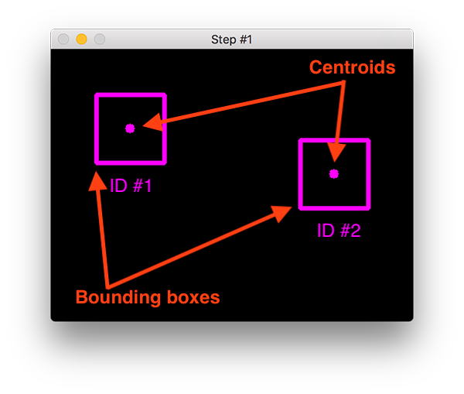
The centroid tracking algorithm
Step 1:Accept bounding box coordinates and compute centroids.
The centroid tracking algorithm assumes that we are passing in a set of bounding box (x, y)-coordinates for each detected object in every single frame.
These bounding boxes can be produced by any type of object detector you would like (color thresholding + contour extraction, Haar cascades, HOG + Linear SVM, SSDs, Faster R-CNNs, etc.), provided that they are computed for every frame in the video.
Once we have the bounding box coordinates we must compute the “centroid”, or more simply, the center (x, y)-coordinates of the bounding box. Figure 1 above demonstrates accepting a set of bounding box coordinates and computing the centroid.

Slide 18
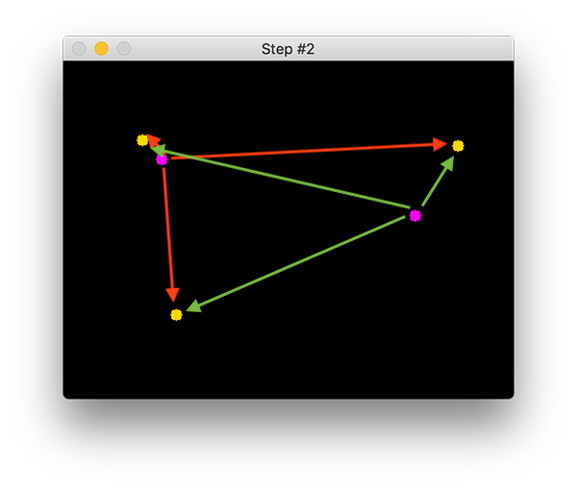
Step 2: Compute Euclidean distance between new bounding boxes and existing objects
For every subsequent frame in our video stream we apply Step #1 of computing object centroids; however, instead of assigning a new unique ID to each detected object (which would defeat the purpose of object tracking), we first need to determine if we can associate the new object centroids (yellow) with the old object centroids (purple). To accomplish this process, we compute the Euclidean distance (highlighted with green arrows) between each pair of existing object centroids and input object centroids.
From Figure 2 you can see that we have this time detected three objects in our image. The two pairs that are close together are two existing objects.
We then compute the Euclidean distances between each pair of original centroids (yellow) and new centroids (purple).

Slide 19
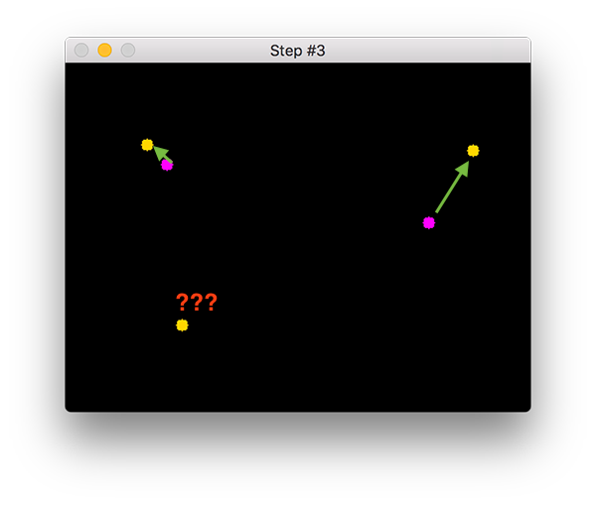
Step 3: Update (x, y)-coordinates of existing objects
The primary assumption of the centroid tracking algorithm is that a given object will potentially move in between subsequent frames, but the distance between the centroids for frames and will be smaller than all other distances between objects.
Therefore, if we choose to associate centroids with minimum distances between subsequent frames we can build our object tracker.
In Figure 3 you can see how our centroid tracker algorithm chooses to associate centroids that minimize their respective Euclidean distances

Slide 20
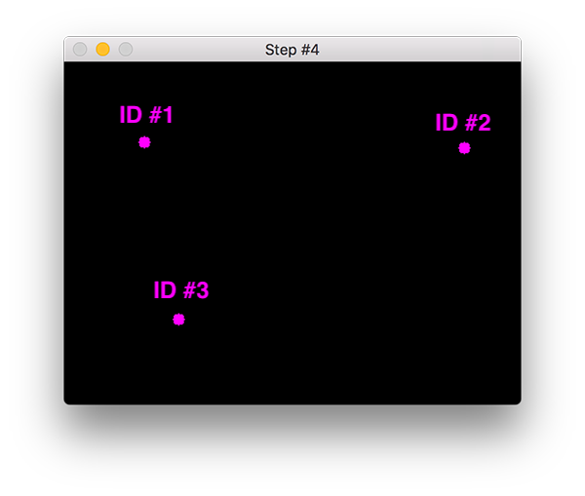
Step 4: Register new objects
In the event that there are more input detections than existing objects being tracked, we need to register the new object. “Registering” simply means that we are adding the new object to our list of tracked objects by:
Assigning it a new object ID
Storing the centroid of the bounding box coordinates for that object
We can then go back to Step #2 and repeat the pipeline of steps for every frame in our video stream.
Figure 4 demonstrates the process of using the minimum Euclidean distances to associate existing object IDs and then registering a new object.

Slide 21
Centroids
Bounding Boxes
ID #1
ID #2
ID #3

Slide 22
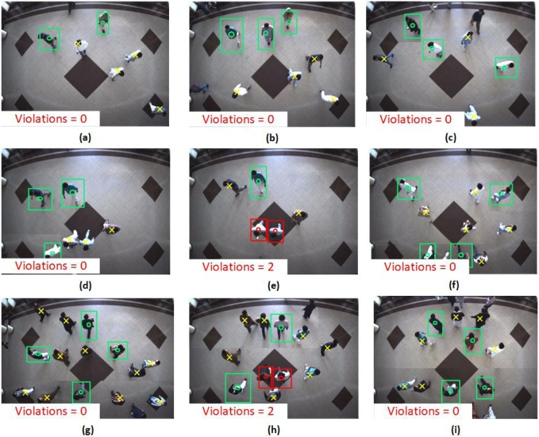
Here is an illustration how violations are being counted using transfer learning

Slide 23
HERE IS A SHORT ILLUTRATION OF THE PROGRAM OUTPUT
The video shows how social distance violation is occurring and the count of the number of violations is being shown and the person violating the social distance is being indicated by red boxes and for those who are not are indicated by green boxes

Slide 24
